Slide 1
Bird Classification with Neural Network Models
By
Laurence Low
and
Anna-Belle Filion

Slide 2
Summary
Objective: Build an image classification model with at least 85% accuracy.
Dataset: 20 bird species, 3208 training images, 100 test images(5 images per species), 100 validation images (5 images per species).
Dataset link: https://www.kaggle.com/datasets/umairshahpirzada/birds-20-species-image-classification/data
CNN model : pre-trained VGG16 model and a simple CNN

Slide 3
Simple CNN model
Develop our own simple CNN model to classify birds

Slide 4
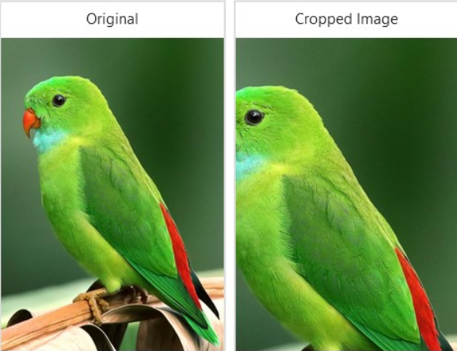
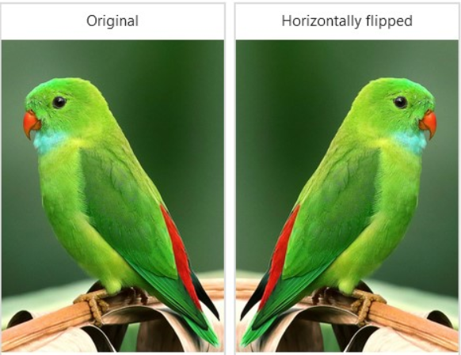
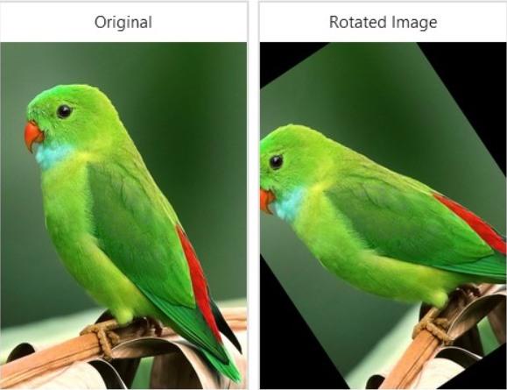
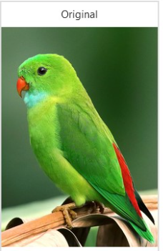
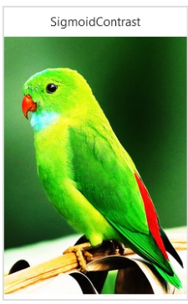
Simple CNN model - Image Augmentation
Cropping
Flipping
Rotation
Brightness

Slide 5
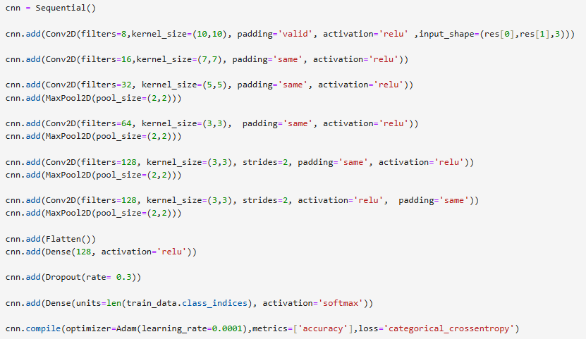
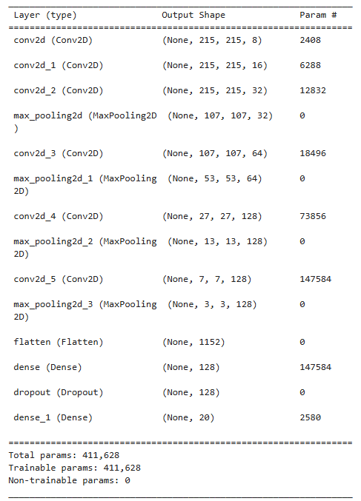

Simple CNN model - Conception

Slide 6
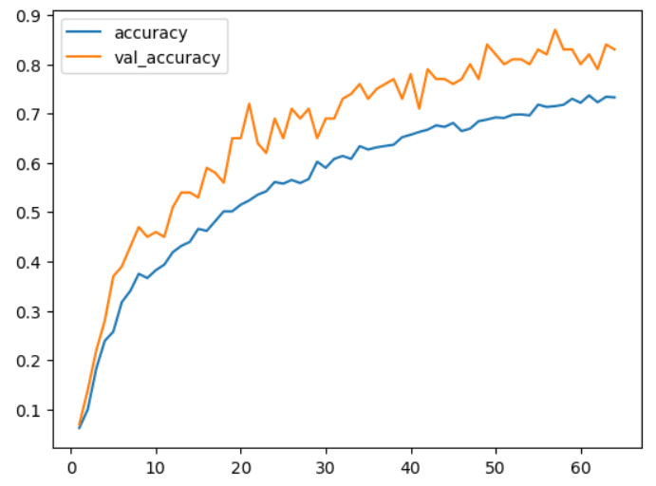
Simple CNN model - Performance
Training accuracy : 74 %
Validation accuracy : 85 %
** Simple CNN model is underfitting **
Solutions:
- Increase quantity of neurons
- Add small features layers
- Increase kernel in later layers

Slide 7
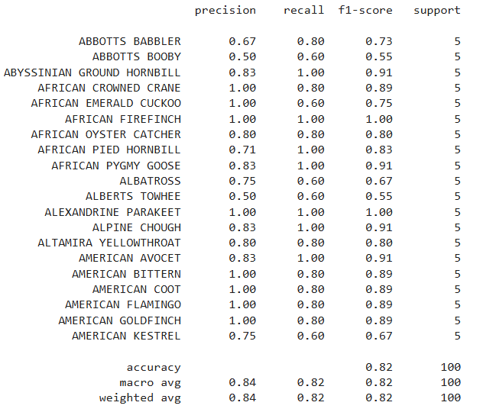
Simple CNN model - Validation
Testing accuracy : 82 %

Slide 8
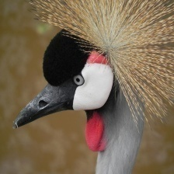
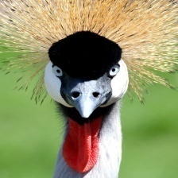
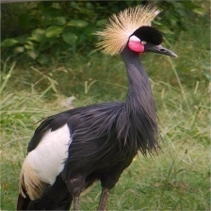
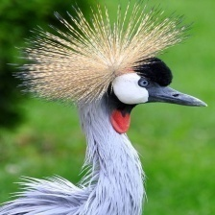
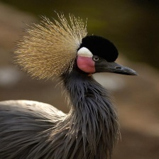
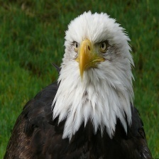


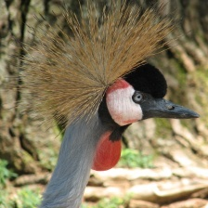
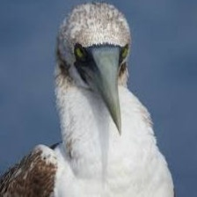
Simple CNN model - Prediction
Southern Bald Eagle
AFRICAN CROWNED CRANE
AFRICAN CROWNED CRANE
AFRICAN CROWNED CRANE
AFRICAN CROWNED CRANE
AFRICAN CROWNED CRANE
ABBOTTS BOOBY

Slide 9
Simple CNN model - Prediction
Accurately predicted the African Crowned Crane
Failed to predict the Southern Bald Eagle
Reason:
The Southern Bald Eagle is not in our training data set
Cannot predict a bird that our model was not trained for

Slide 10
Pre-trained VGG16 model
VGG16 CNN model was develop by the Visual Geometry Group (Oxford University)

Slide 11
Data Augmentation (Training data)
rescale=1/255
rotation_range=20
width_shift_range=0.2
height_shift_range=0.2
shear_range=0.2
zoom_range=0.2
horizontal_flip=True
fill_mode='nearest'

Slide 12
Data generator specifications (Training, Validation and Test)
target_size=(224, 224)
batch_size=32,
class_mode='categorical',

Slide 13
Build on VGG16 Model
weights='imagenet’
include_top=False
input_shape=(224, 224, 3)
layers.GlobalAveragePooling2D()
layers.Dense(512, activation='relu')
layers.Dropout(0.5)
layers.Dense(len(train_data.class_indices), activation='softmax')

Slide 14
EarlyStopping and no. of Epochs
EarlyStopping:
monitor=‘val_loss’
patience=5
Epochs:
Epochs = 50

Slide 15
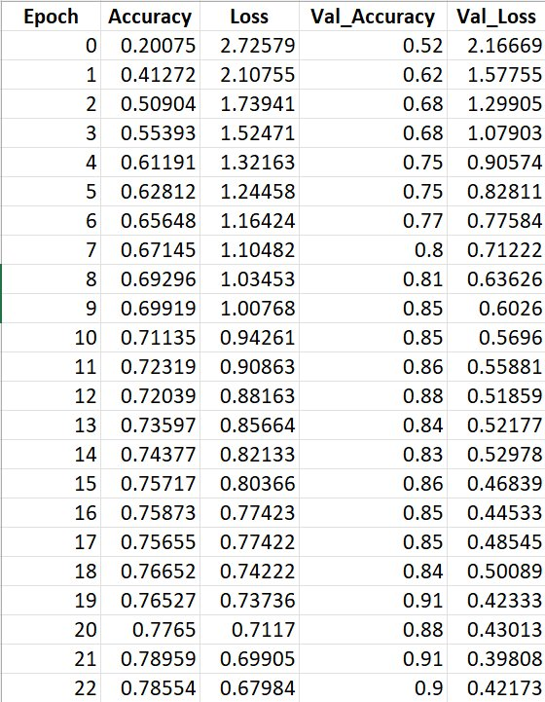
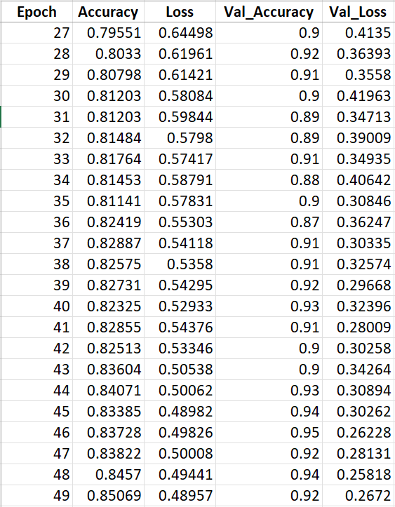
History
At Epoch 50 (index 49):
- Accuracy = 85.069%
- Val_Accuracy = 92%

Slide 16
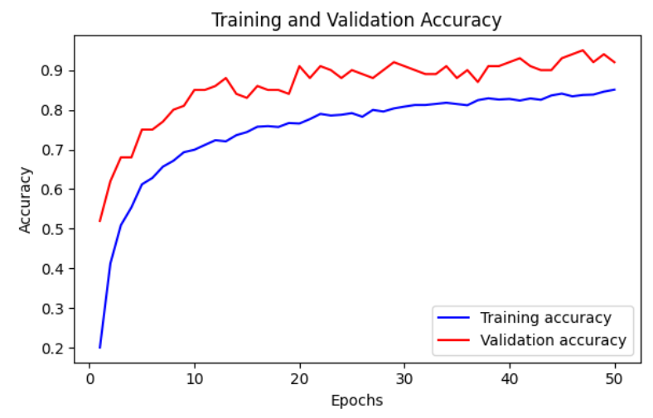
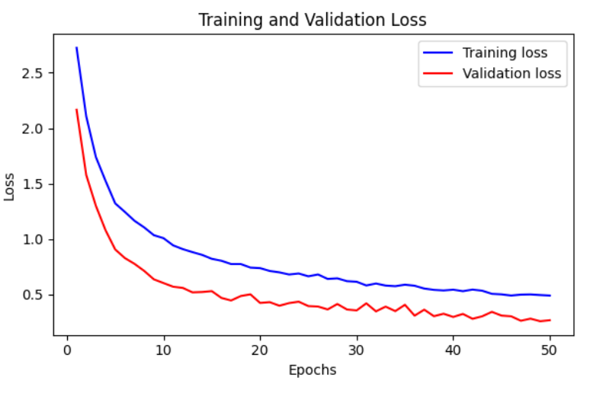
Plot History

Slide 17
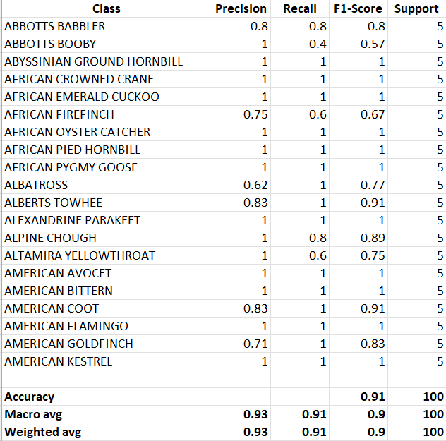
Test Accuracy and Classification Report
The Test Accuracy was 91%.
Classification Report Accuracy
displayed as 91%.

Slide 18
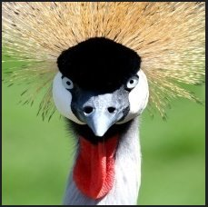
Prediction
Image used for prediction from
‘images to predict folder’: ‘2.jpg’
Prediction Result:
The predicted bird species was
the AFRICAN CROWNED CRANE.

Slide 19
Thank you

